Slide 1
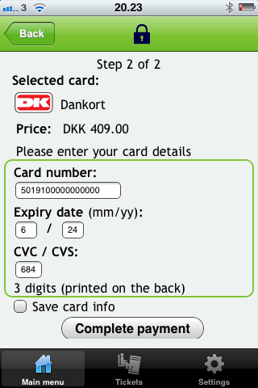
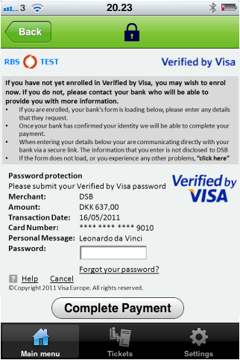
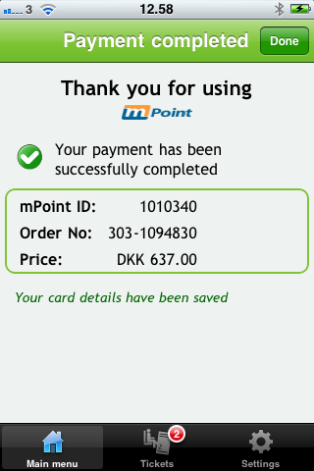
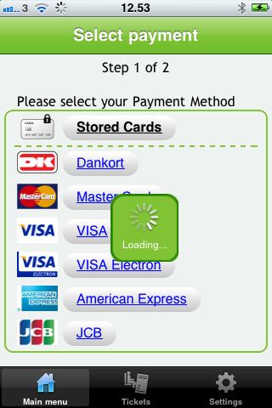
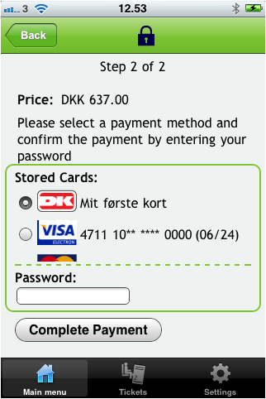
3D SEcure
Optimized input fields
Intuitive storage of cards
Enter card details
3D Secure auth
Payment completed
Select payment method
User defined card names
Seamless support for 3D Secure
Authorise payment

